Slide 1
Modelling of systems

Slide 2
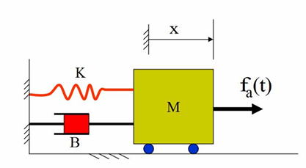
Mech. system
Solving:
Ans. is TF is Laplace [O/P /I/P]
= X(s)/F(s) = 1/( M s² + Bs + k )

Slide 3
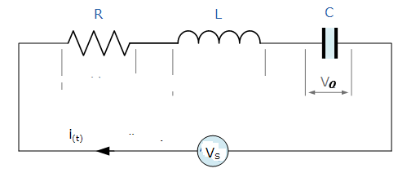


RLC series circuit
Taking Laplace and then the TF is

